Slide 1
AI Lecture 3 Support Vector Machines
Chia-Hui Chang
2022/9/29

Slide 2
SVM Tutorial Outline
Linear separable
Maximum margin (Geometric view)
Hinge Loss (General approach)
Solving the optimization problem
Quadratic Optimization with linear constraints
Gradient Descent (Neural Network Approach)
Non-Linear Separable
Soft margin
Kernel Trick

Slide 3
Maximum Margin Classifier
SVMs maximize the margin around the separating hyperplane.
The decision function is fully specified by a subset of training samples, the support vectors.
Figure source: All you Need to Know About SVM

Slide 4
Optimization Formulation
Geometric view:
Decision boundary: w^{T}x+b=0
Positive hyperplane: w^{T}x+b=1
Negative hyperplane: w^{T}x+b=-1
Classifier f(x) = sign(w^{T}x + b)
Width of the margin = 2/|w|
Optimization Problem
w: hyperplane normal vector
x_{i}: data point n
y_{n}: class of data point n (+1 or -1)
Why?
Find w and b such that the margin
is maximized; and for all {(x_{n} , y_{n})}
w^{T}x_{n} + b ≥ 1 if y_{n}=1; w^{T}x_{n} + b ≤ -1 if y_{n} = -1

Slide 5
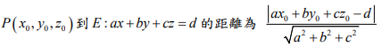
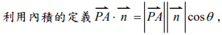
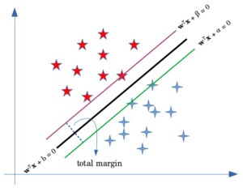
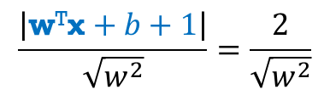
點到平面距離公式
台南二中數學科教學網站
Proof hint:
Compute the distance of a point on Positive hyperplane: w^{T}x+b=1 to Negative hyperplane w^{T}x+b=-1
$$\frac{\left|\text{w}\text{T}\text{x}+b+1\right|}{\sqrt{w^{2}}}=\frac{2}{\sqrt{w^{2}}}$$

Slide 6
Distance of a point to a plane
Inner product
w^{T}x+b=0
Let x_{n} be a point on the plane w^{T}x_{n}+b=1

Slide 7


下列有關 Maximum-Margin Classifier 何者為誤?
ⓘ Start presenting to display the poll results on this slide.

Slide 8
SVM 的 loss 是什麼?
ⓘ Start presenting to display the poll results on this slide.

Slide 9
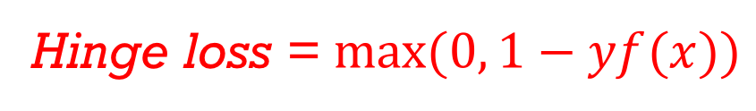
Linear Classifier with Hinge Loss function
Hinge loss = $max⁡(0, 1−yf(x))$
Hinge Loss
Sigmoid +
cross entropy
When will the data be linear separable?
Hinge Loss vs. 0-1 loss, which is better?
Square loss
Sigmoid + Square loss
Notes:
9/28/2022
9
9

Slide 10
Linear SVM
Neural Network version:
Yichuan Tang , “Deep Learning using Linear Support Vector Machines”, ICML 2013 Challenges in Representation Learning Workshop
Step 1: Function (Model)
Step 2: Loss function
Step 3: gradient descent?
Regularization

Slide 11
下列有關 Hinge Loss Function 何者錯誤?
ⓘ Start presenting to display the poll results on this slide.

Slide 12
Solve the Optimization problem
Sec. 15.1
Quadratic optimization problem:
A better formulation
式1
Find w and b such that
is maximized; and for all {(x_{i} , y_{i})}
w^{T}x_{i} + b ≥ 1 if y_{i}=1; w^{T}x_{i} + b ≤ -1 if y_{i} = -1
Find w and b such that
Φ(w) =½ w^{T}w is minimized;
and for all {(x_{i} ,y_{i})}: y_{i} (w^{T}x_{i} + b) ≥ 1

Slide 13
Lagrange Formulation
式2
Intuition: If y_{n}(w^{T}x_{n} + b) ≥ 1 (i.e. correct classification), then α_{n}=0
else α_{n}>0 (i.e. penalty).
Solve for unstrained QP:
➾
代入式2

Slide 14
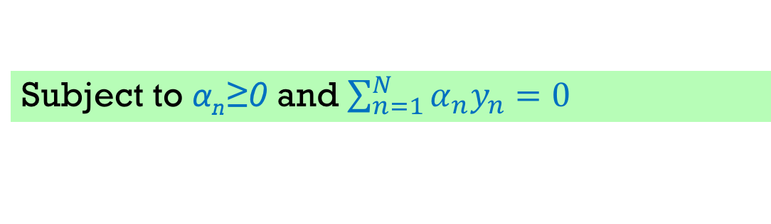
Dual Form
Sec. 15.1
式3
Subject to α_{n}≥0 and $\sum_{n=1}^{N}{α_{n}y_{n}=0}$
式4
Notes:
這個二次規劃(quadratic programming)的問題可以用lagrange multiplier解(表示成dual problem)
後面幾張投影片在講怎麼從上面那塊推導到下面這塊

Slide 15
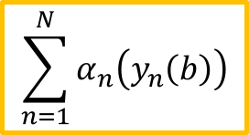
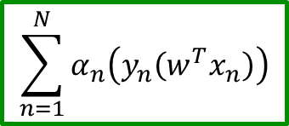
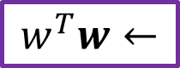
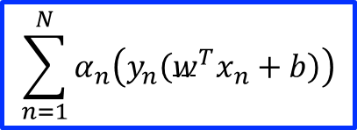
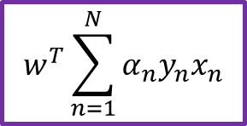
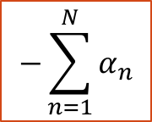
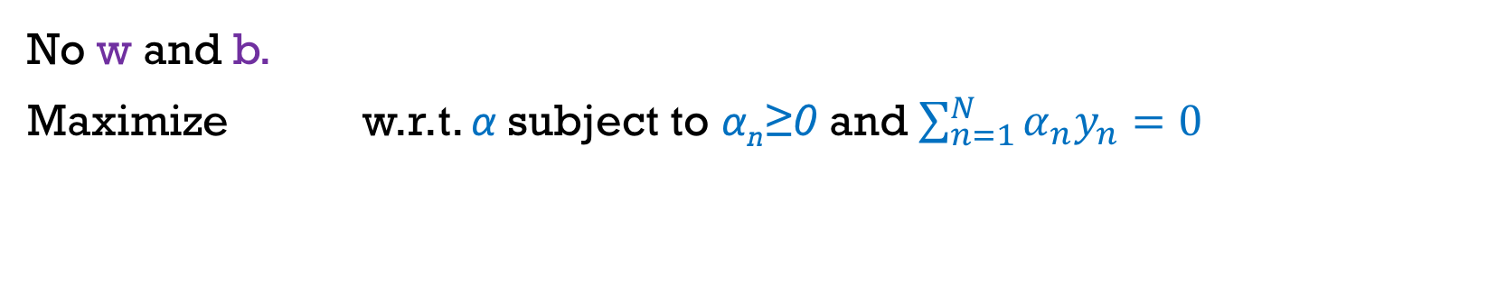
Dual Form derivation
$$\sum_{n=1}^{N}{α_{n}\left(y_{n}\left({w^{T}x}_{n}+b\right)\right)}$$
$$−\sum_{n=1}^{N}{α_{n}}$$
$$\sum_{n=1}^{N}{α_{n}\left(y_{n}\left(w^{T}x_{n}\right)\right)}$$
$$w^{T}\sum_{n=1}^{N}{α_{n}y_{n}x_{n}}$$
$$\sum_{n=1}^{N}{α_{n}\left(y_{n}\left(b\right)\right)}$$
$$w^{T}w←$$
No w and b.
Maximize w.r.t. α subject to α_{n}≥0 and $\sum_{n=1}^{N}{α_{n}y_{n}=0}$

Slide 16
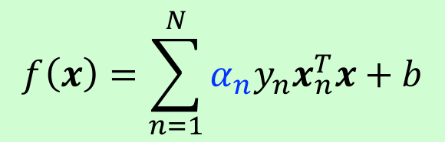
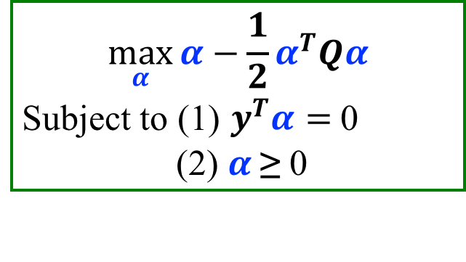
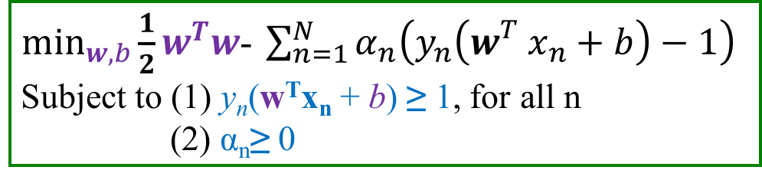
From Duel to Prime Problem
Sec. 15.1
Once we get the answer of the dual solution
$$\max_{α}{α−\frac{1}{2}α^{T}Qα}$$
Subject to (1) $y^{T}α=$ 0
(2) $α$≥ 0
How to compute b?
$\min_{w,b}{\frac{1}{2}w^{T}w}$- $\sum_{n=1}^{N}{α_{n}\left(y_{n}\left({w_{}^{T}x}_{n}+b\right)−1\right)}$
Subject to (1) y_{n}(w^{T}x_{n} + b) ≥ 1, for all n
(2) α_{n}≥ 0
$$f\left(x\right)=\sum_{n=1}^{N}{α_{n}y_{n}x_{n}^{T}x}+b$$
Notes:
這個二次規劃的問題可以用Lagrange multiplier解(表示成dual problem)

Slide 17
Linear SVMs: Summary
Sec. 15.2.1
Quadratic optimization algorithms can identify which training points x_{k} are support vectors with non-zero Lagrangian multipliers α_{k}.
Solving the optimization problem involved computing the inner products x_{i}^{T}x_{j} between all pairs of training points.
Both in the dual formulation of the problem and in the solution, training points appear only inside inner products:

Slide 18
通常會用什麼方法解SVM的限制式?
ⓘ Start presenting to display the poll results on this slide.

Slide 19
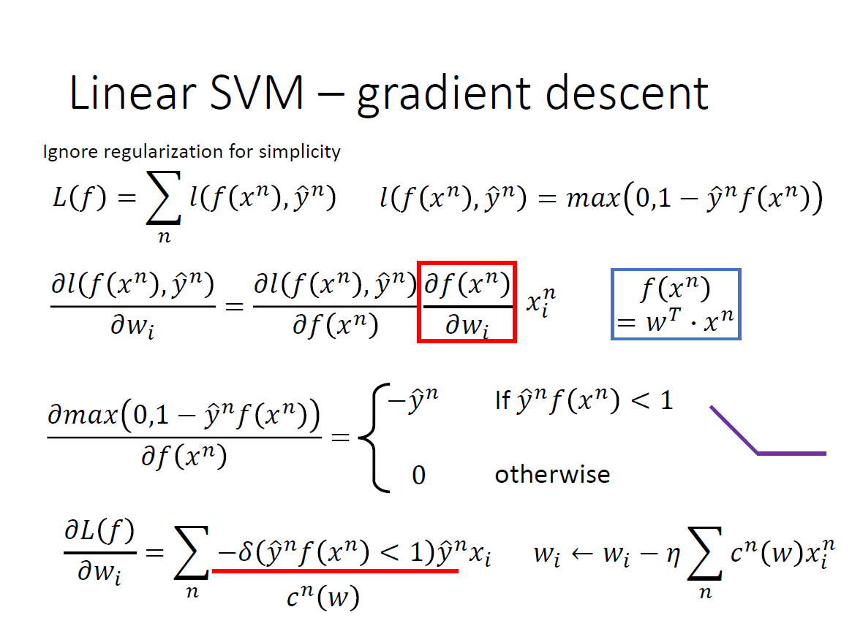
Notes:
strategy for finding the local maxima and minima of a function subject to equality constraints

Slide 20
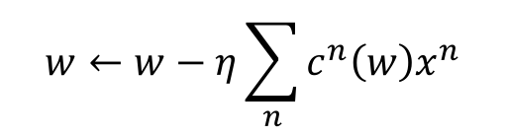
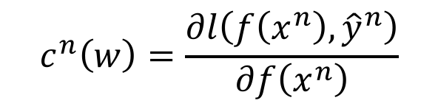
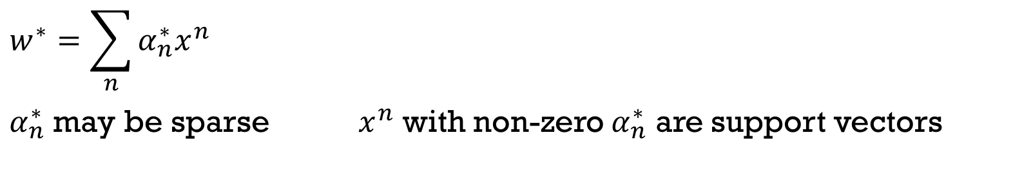
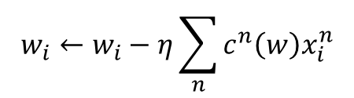
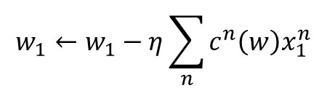
Linear SVm via gradient descent
$$w^{∗}=\sum_{n}{α_{n}^{∗}x^{n}}$$
$α_{n}^{∗}$ may be sparse $x^{n}$ with non-zero $α_{n}^{∗}$ are support vectors
Linear combination of data points
If w initialized as 0
$$w_{1}←w_{1}−η\sum_{n}{c^{n}\left(w\right)x_{1}^{n}}$$
$$w←w−η\sum_{n}{c^{n}\left(w\right)x^{n}}$$
……
$$w_{i}←w_{i}−η\sum_{n}{c^{n}\left(w\right)x_{i}^{n}}$$
$$c^{n}\left(w\right)=\frac{∂l\left(f\left(x^{n}\right), {\hat{y}}^{n}\right)}{∂f\left(x^{n}\right)}$$
Hinge loss: usually zero
……
$$w_{k}←w_{k}−η\sum_{n}{c^{n}\left(w\right)x_{k}^{n}}$$
c.f. for logistic regression,
it is always non-zero

Slide 21
Two types of Linearly non-separable
Slightly Seriously

Slide 22
Soft Margin Classification
Sec. 15.2.1
ξ_{i}
ξ_{j}
Notes:
If the training data is not linearly separable, slack variables ξ_{i} can be added to allow misclassification of difficult or noisy examples.
Allow some errors
Let some points be moved to where they belong, at a cost
Still, try to minimize training set errors, and to place hyperplane “far” from each class (large margin)

Slide 23
New optimization problem for Soft Margin Classification
Sec. 15.2.1
Parameter C can be viewed as a way to control overfitting
A regularization term
Find w and b such that
Φ(w) =½ w^{T}w is minimized and for all {(x_{i} ,y_{i})}
y_{i} (w^{T}x_{i} + b) ≥ 1
Find w and b such that
Φ(w) =½ w^{T}w + CΣξ_{i} is minimized and for all {(x_{i} ,y_{i})}
y_{i} (w^{T}x_{i} + b) ≥ 1- ξ_{i} and ξ_{i} ≥ 0 for all i
Notes:
The old formulation( hard margin):
The new formulation( soft margin) incorporating slack variables:
Parameter C can be viewed as a way to control overfitting
A regularization term

Slide 24
Lagrange formulation - Derivation for Soft Margin Classification
Only w.r.t. original variables

Slide 25
Lagrange formulation for Soft Margin Classification
Sec. 15.2.1
and

Slide 26
下列關於 Soft margin classification 的敘述何者錯誤?
ⓘ Start presenting to display the poll results on this slide.

Slide 27
Lagrange formulation for Soft Margin Classification – Solution
Sec. 15.2.1
The dual problem for soft margin classification:
Neither slack variables ξ_{i} nor their Lagrange multipliers appear in the dual problem!
Again, x_{i} with non-zero α_{i} will be support vectors.
Solution to the dual problem is:
Q(α) =Σα_{i} - ½ΣΣα_{i}α_{j}y_{i}y_{j}x_{i}^{T}x_{j} is maximized and
(1) Σα_{i}y_{i} = 0
(2) 0 ≤ α_{i} ≤ C for all α_{i}
w is not needed explicitly for classification!
w = Σα_{i}y_{i}x_{i}
b = y_{k}(1- ξ_{k}) - w^{T}x_{k} where k = argmax α_{k’}
f(x) = Σα_{i}y_{i}x_{i}^{T}x + b
k’

Slide 28
Non-linear SVMs
Sec. 15.2.3
Linearly separable:
Non-linear separable
Mapping data to a higher-dimensional space:
0
x
0
x
x²
0
x

Slide 29
Non-linear SVMs: Feature spaces
Sec. 15.2.3
The original feature space can always be mapped to some higher-dimensional feature space where the training set is separable:
Φ: x → φ(x)

Slide 30
from x to z space
Can we compute K(x,x’) without transforming x and x’?

Slide 31
The “Kernel Trick”
Sec. 15.2.3

Slide 32
Kernel Functions
Mercer’s theorem:
Every semi-positive definite symmetric function is a kernel
Semi-positive definite symmetric functions correspond to a semi-positive definite symmetric Gram matrix:
K=
K(x₁,x₁) | K(x₁,x₂) | K(x₁,x₃) | … | K(x₁,x_{N})
K(x₂,x₁) | K(x₂,x₂) | K(x₂,x₃) |  | K(x₂,x_{N})
… | … | … | … | …
K(x_{N},x₁) | K(x_{N},x₂) | K(x_{N},x₃) | … | K(x_{N},x_{N})

Slide 33
Common Kernels
Sec. 15.2.3
Linear
Polynomial
Gaussian (Radial-Basis Function network)
Sigmoid
K(x_{i},x_{j})= tanh(β₀x_{i} ^{T}x_{j} + β₁)

Slide 34
下列有關 Kernel Trick 的敘述何者錯誤?
ⓘ Start presenting to display the poll results on this slide.

Slide 35
References
Machine Learning Foundation by Prof. Hsuan-Tien Lin
Machine Learning 2016 by Prof. Hung-Yi Lee
Learning from data by Prof. Y. Abu-Mostafa

